Slide 1

Udacity Self Driving car engineer Nanodegree Program Chapter1- Computer Vision
Document prepared by - Poluri Nikhil Koundinya
INTRODUCTION TO DL USING CV

Slide 2
1- Introduction to DL for Computer Vision

Slide 3
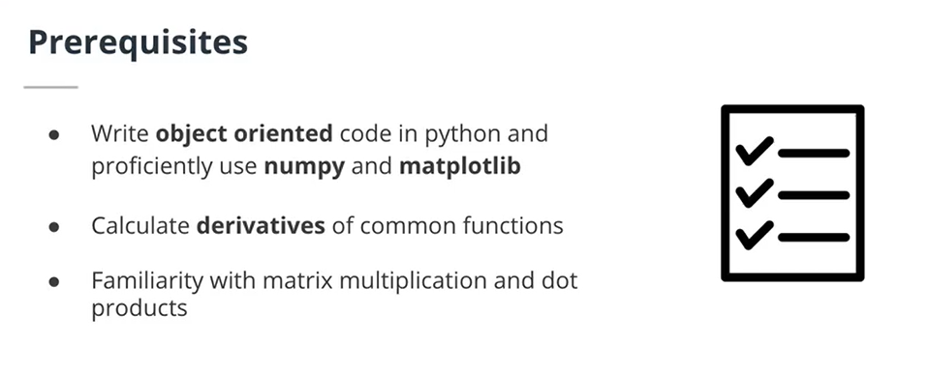

Slide 4
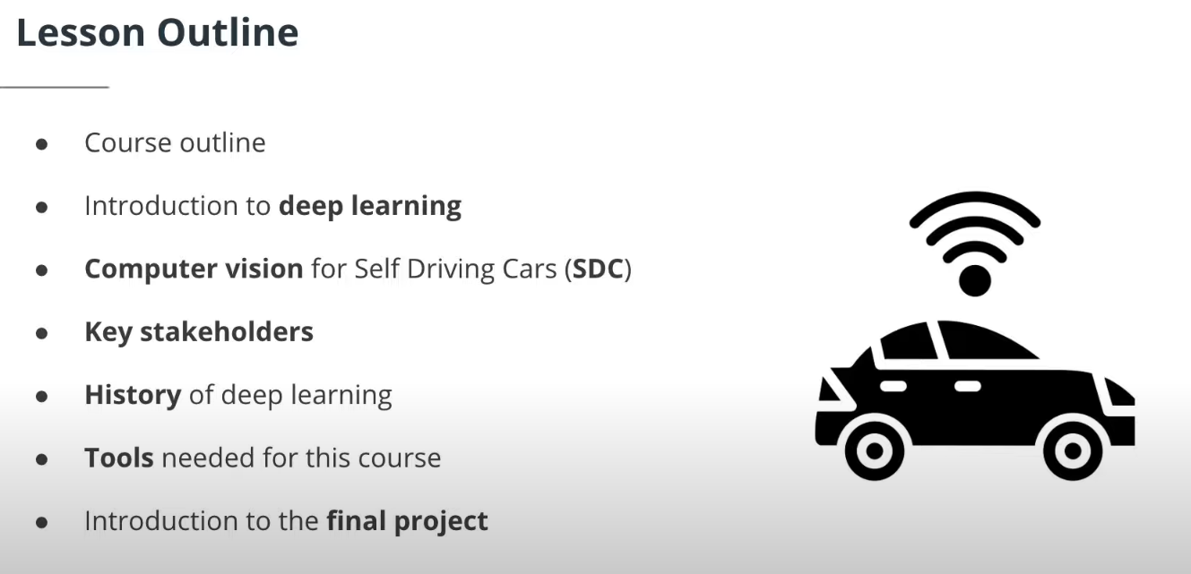
The prerequisites for this course are to be able to:
Write object oriented code in Python and proficiently use the numpy and matplotlib libraries (such as for matrix multiplication and simple plotting)
Calculate derivatives of common functions (basic calculus skills) such as x^2, 1/x
Compute multiplication of matrices and dot products (basic linear algebra skills)

Slide 5
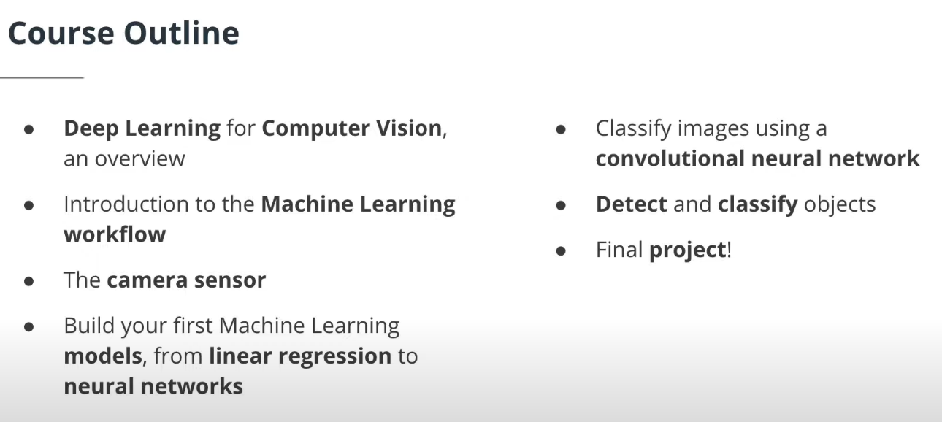

Slide 6
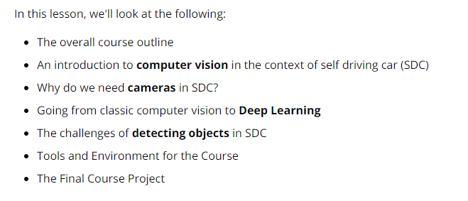
Lesson Outline

Slide 7
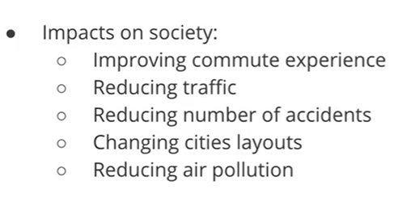
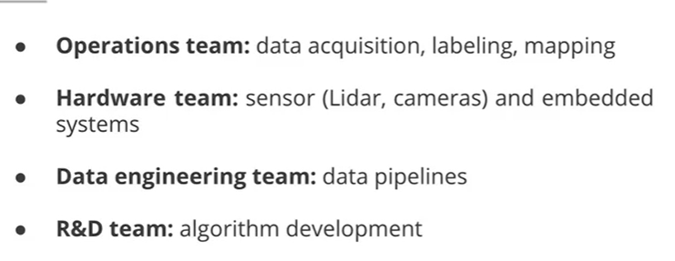
Impacts of SDC on Society and various teams involved
Key Stakeholders

Slide 8
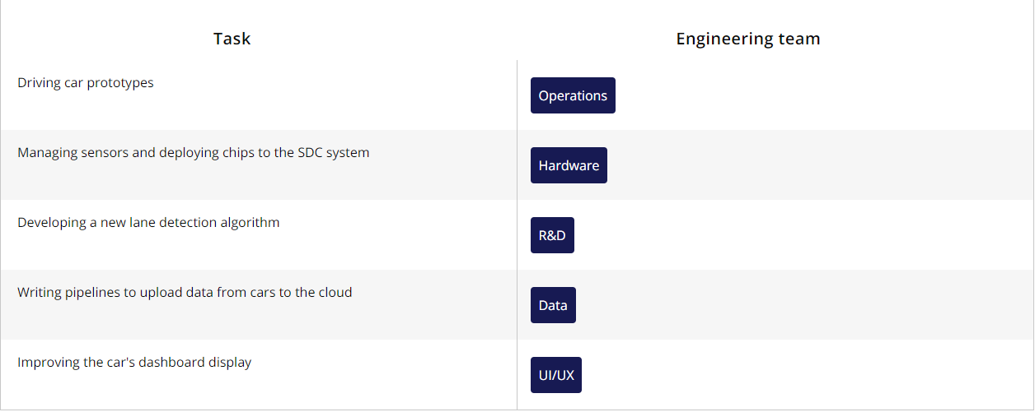
Example tasks for various Engineering teams

Slide 9
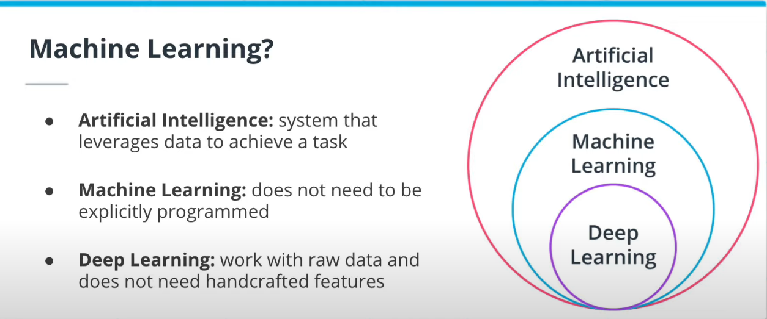
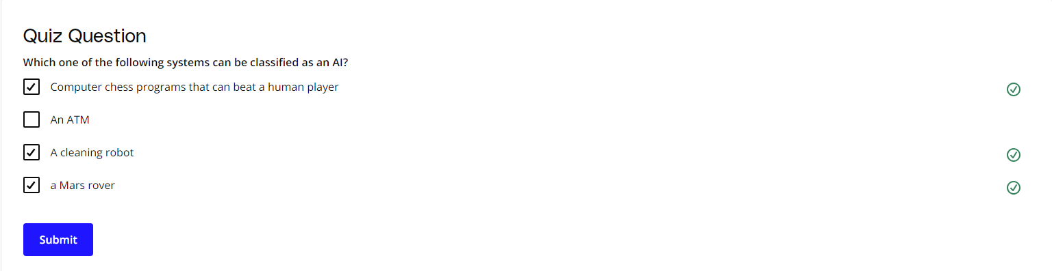
How is DL different from ML? DL can work with Raw data while in ML sometimes we have to handcraft features. we are classifying a image if it has a dog or not. In an ML approach, we build the dog features like the ear, nose detectors. Ans then we find these in the images. In DL, we give the model images directly

Slide 10
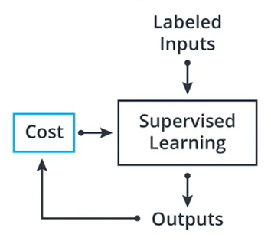
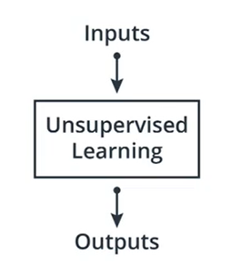
Machine Learning
Supervised Learning
Unsupervised Learning
Reinforcement Learning
Classification
Regression
Clustering

Slide 11
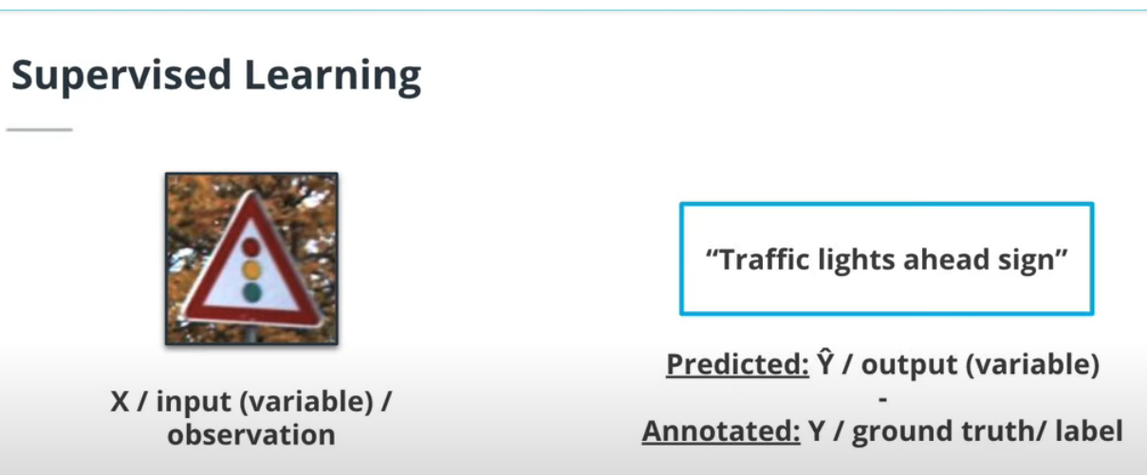
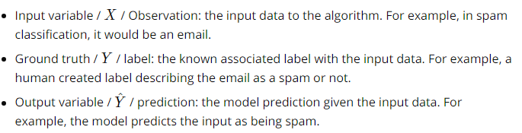
Note: In supervised learning, we require access to labelled data. The labelling task comes at a great cost. There are companies that perform only labelling task for DL teams.
These terms will be frequently encountered in ML problem.

Slide 12
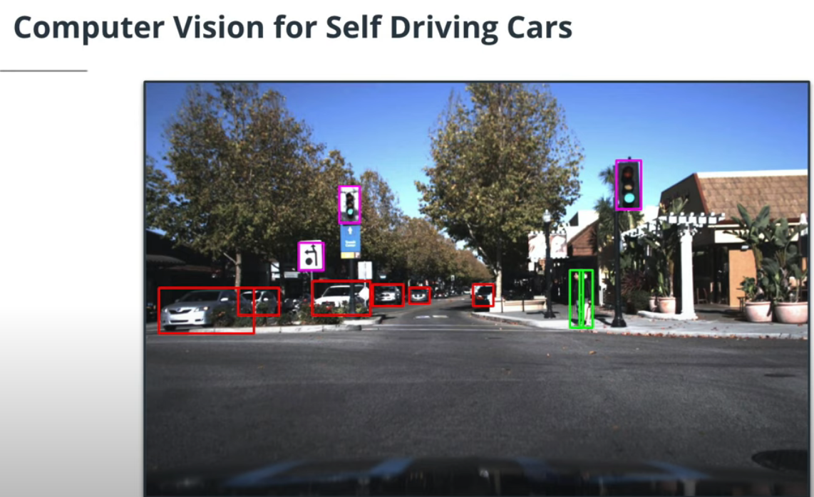
Why CV Is Important for SDC
Deep Learning algorithms are now the state of the art (SOTA) in most computer vision problems, such as image classification or object detection. Therefore, they are now in every SDC system. However, using deep learning adds additional constraints to the system because they require more computational power.
What can a CV system do in a self driving car
1- car detection
2- Traffic light and traffic sign
3- Pedestrian detection

Slide 13
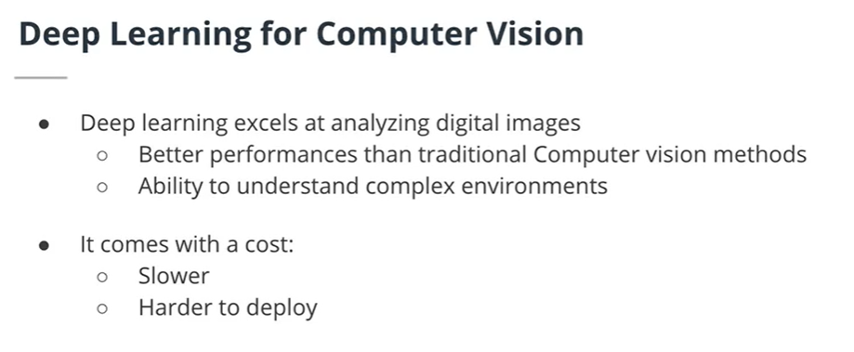
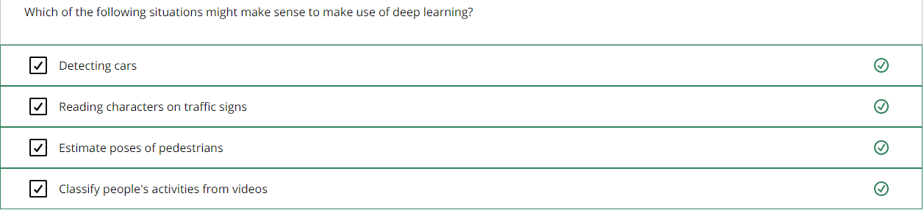

Slide 14
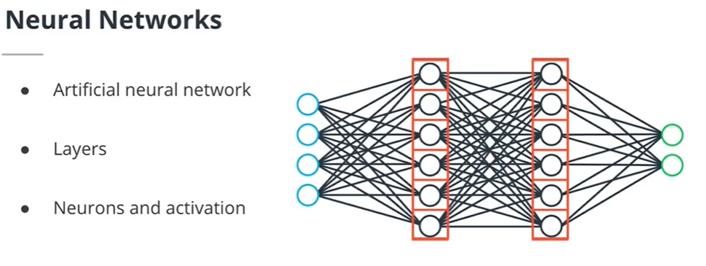
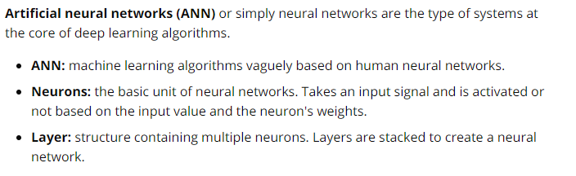
Basics and History of DL
Hidden layers
Input layers
Output layers
The term DL comes from Deep neural networks where many layers are stacked. In this figure, each neuron in a layer is connected to each neuron of the previous layer and connected to each neuron of the next layer. This is called Feed Forward Neural N/W. A neuron receives an input signal and are activated or not based on this input. We say that the neuron is firing if it is activated.

Slide 15
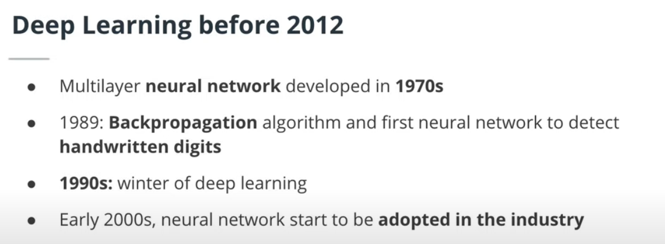

Slide 16
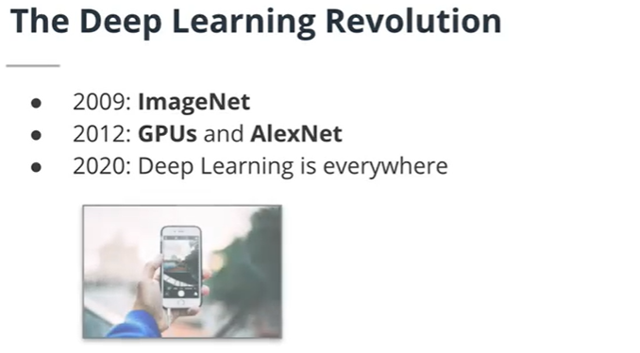
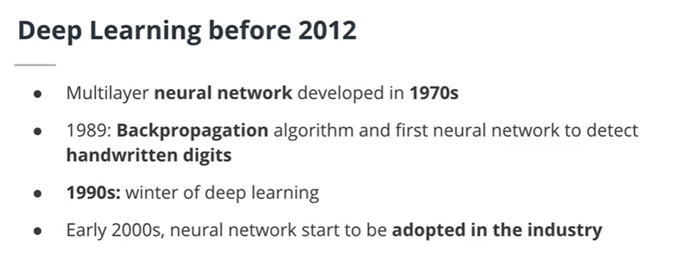

Slide 17
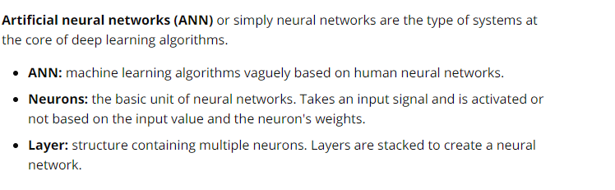
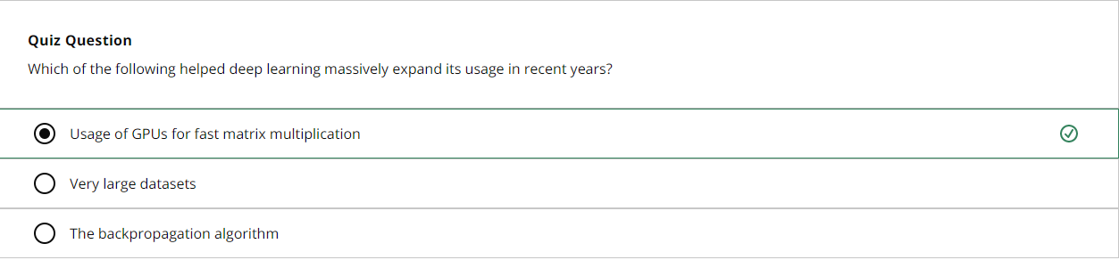

Slide 18
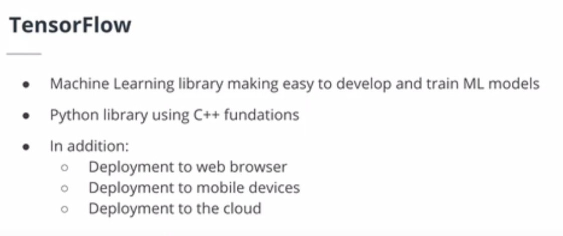
Introduction to TensorFlow

Slide 19

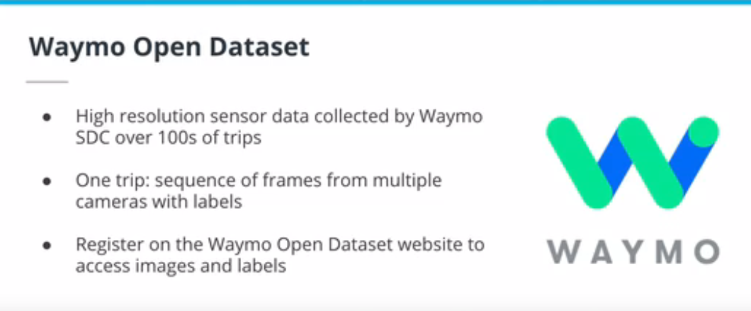
Tools, Environment & Dependencies

Slide 20
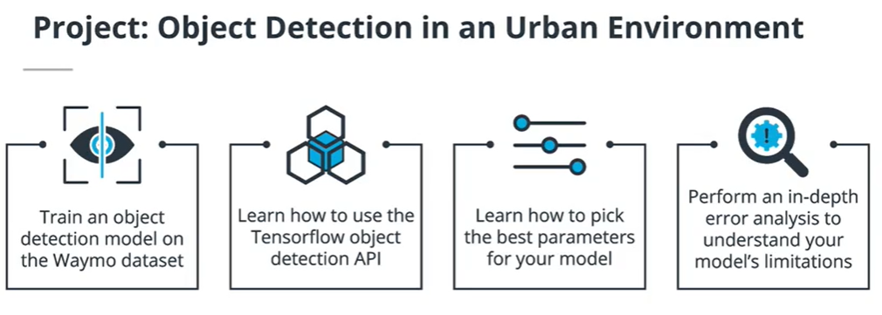
Module1 final project details
For the final project of this course, you will have to train an object detection model using the TensorFlow Object Detection API. This API simplifies the training and development of object detection models in TensorFlow. You will learn how to master it in this project. This API makes the exploration of the optimal parameters for your model extremely easy by using config files. Because you should try to create the best possible model, you will have to tweak and test different parameters. Finally, you will have to perform an in-depth error analysis.

Slide 21
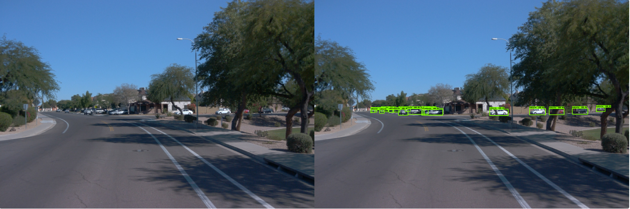

Slide 22
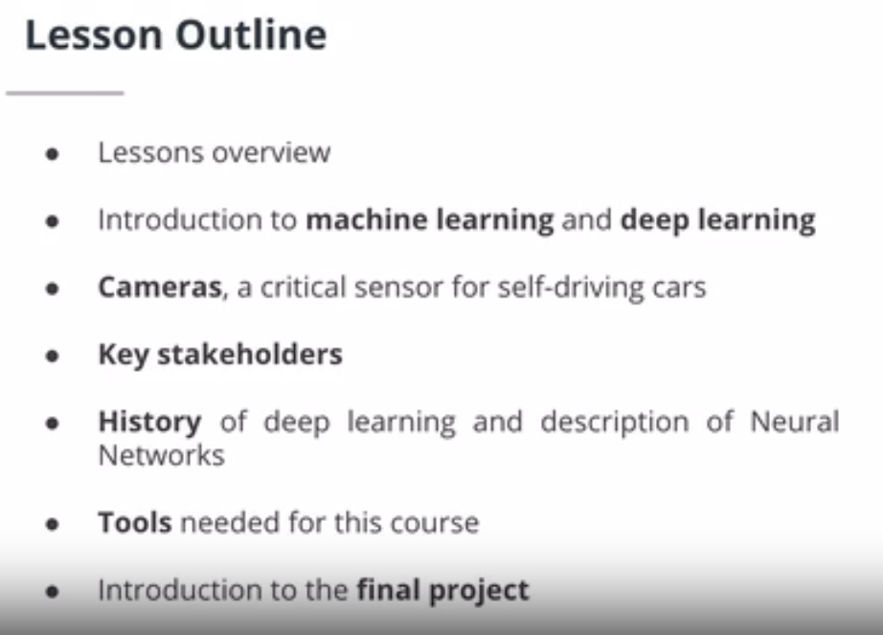

Slide 23
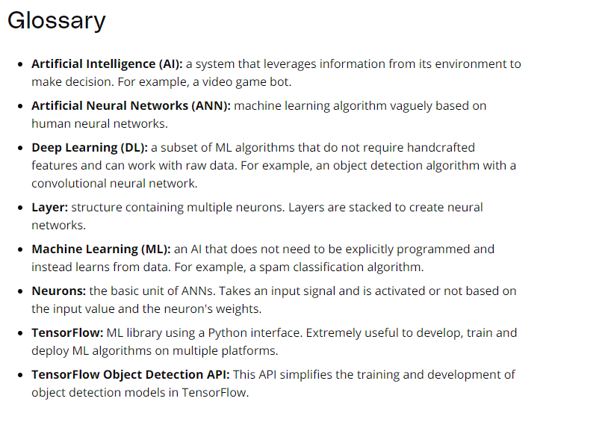

Slide 24
The End

Slide 25
2- The ML Workflow

Slide 26
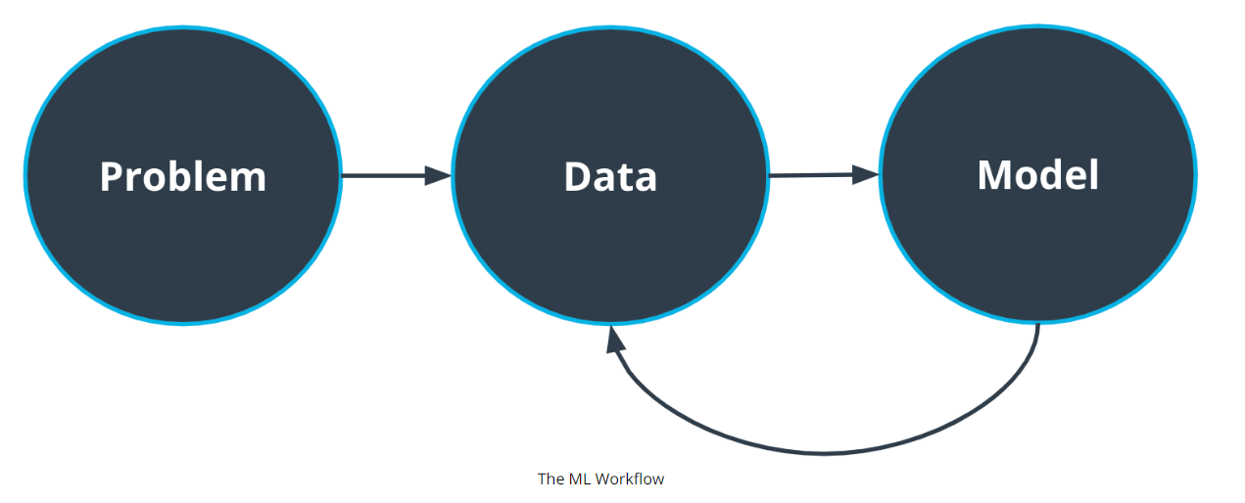
The Big Picture
1-Which approach is best for this problem?
2-What are the constraints? Eg- are there limitations because of the hardware?
Then we have feedback loop. We can decide if we require more data for the model
1- Frame the problem.
2- What are we trying to achieve here? 3- Why?
4- Who cares about this problem?
5- Do we even need ML?
want to solve?
1- How much data do we need?.
2-Is data easy to obtain? 3- How much processing is required?
Once our dataset is ready, we can focus on the model

Slide 27
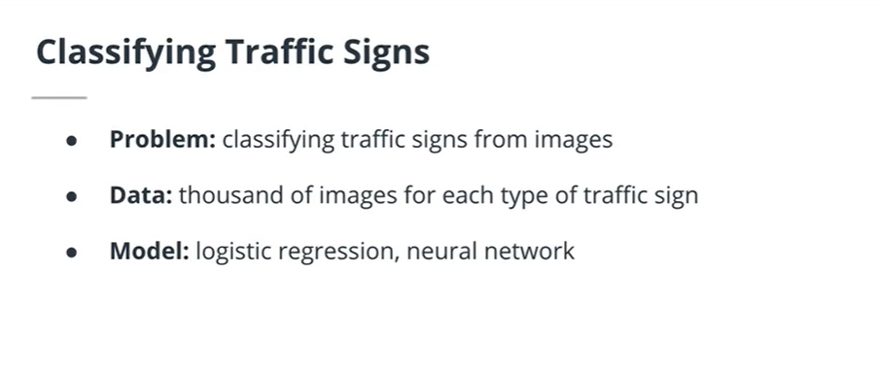
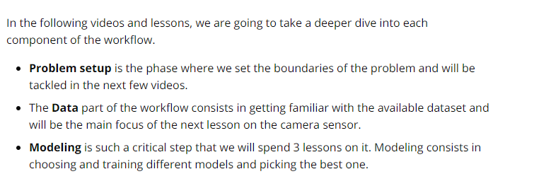
Example: For traffic sign classification problem

Slide 28
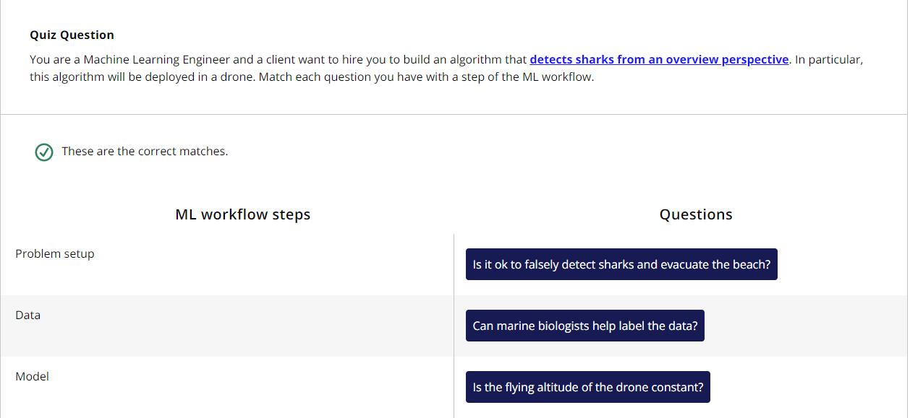

Slide 29
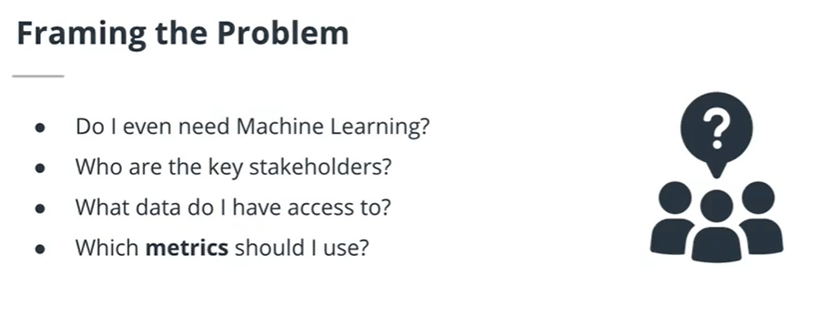
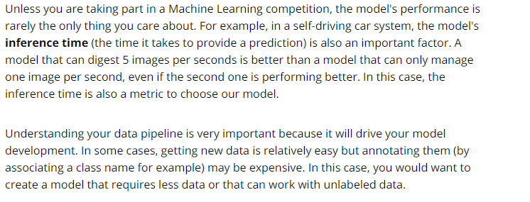
For Business oriented ML problems:

Slide 30
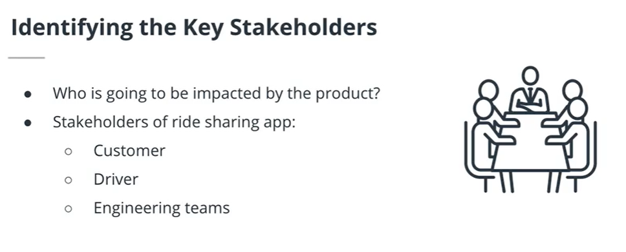
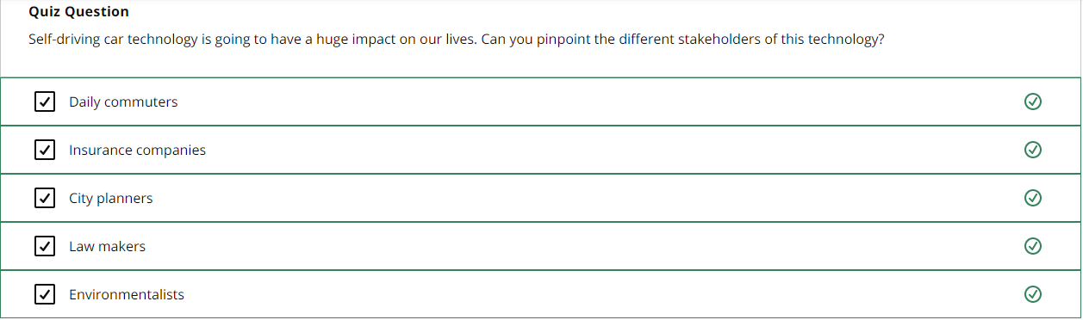

Slide 31
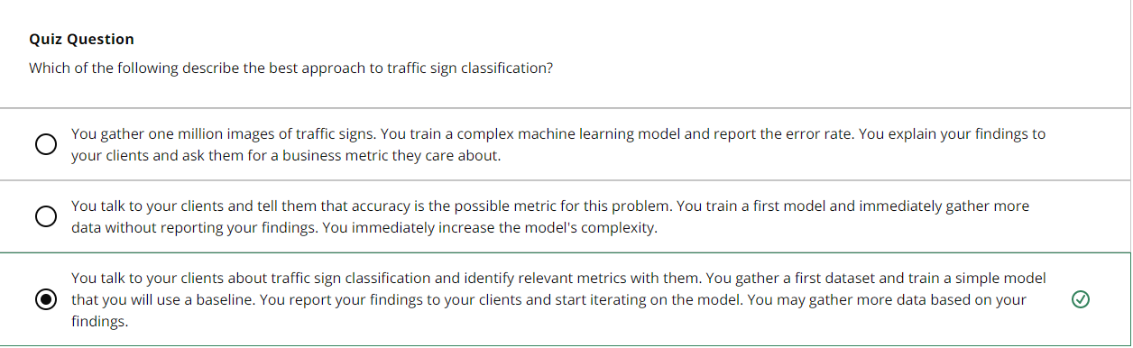
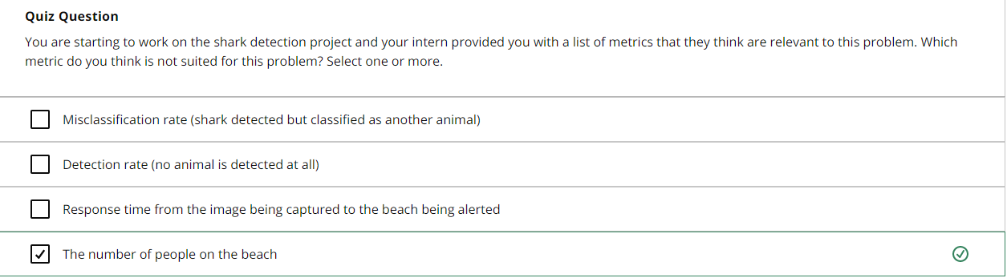

Slide 32
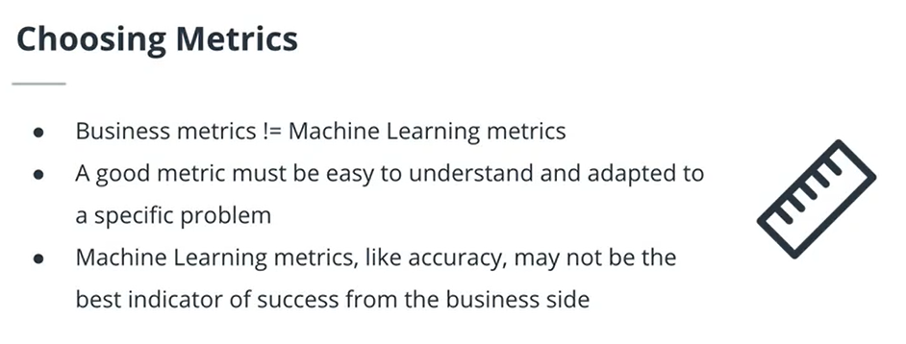
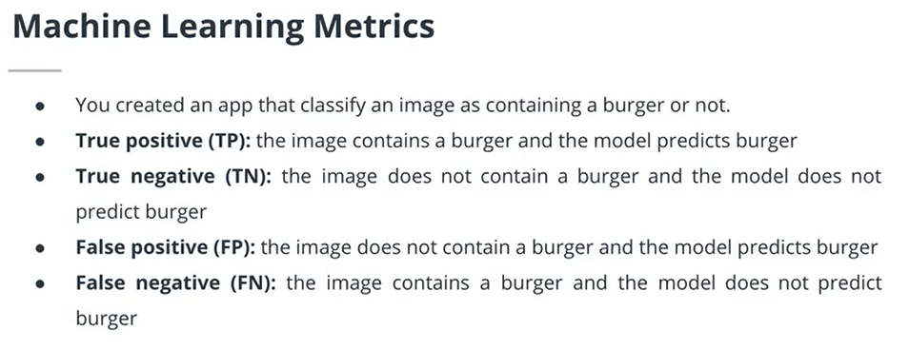

Slide 33
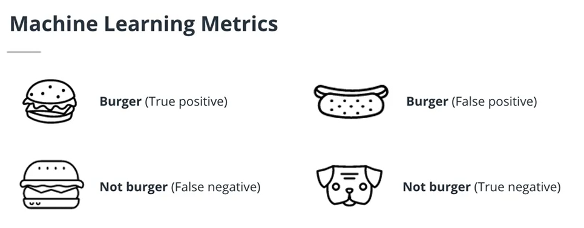
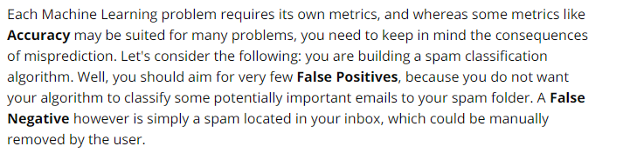
The image has a burger and algorithm detected a burger
The image has a hot- dog but the algorithm detected a burger
The image has a burger and algorithm classifies it as Not burger
The image has a dog and the algorithm does not classify it as burger

Slide 34
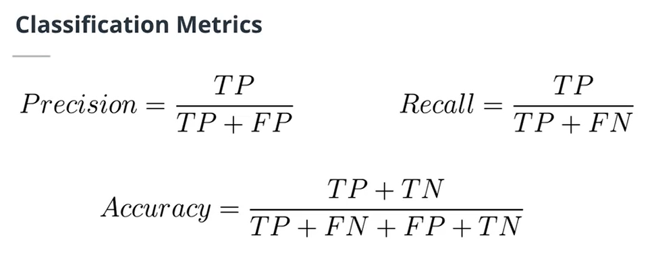
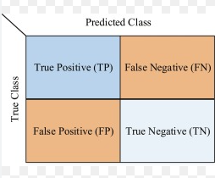
CONFUSION MATRIX

Slide 35
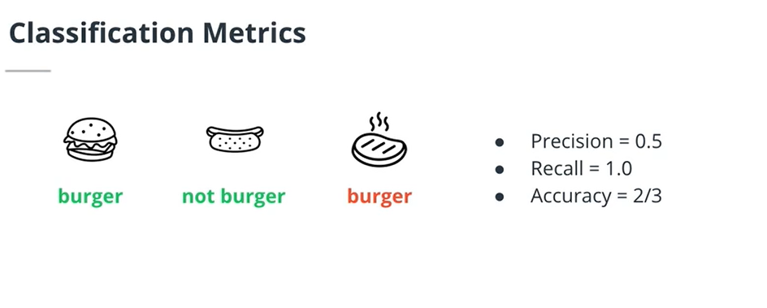
Precision: Of the elements classified as a particular class, how many did we get right? For example, we classified 6 images as containing burgers and only 5 of them actually contain a burger. The precision is 5/6.
Recall: The number of images classified correctly divided by the total number of images. For example, we have 40 images of burgers and we classified 15 of them correctly. The recall is 15/40.
Accuracy: (Only for classification problems) The number of correctly classified images over the total number of images.
Image has a “burger” and burger is predicted
Image has a hot dog and “Not burger” is predicted
Image has a stake and a “burger” is predicted
Therefore we have one TP, one TN and one FP. So, we can calculate using Precision, recall and accuracy using the formulas in the previous page.

Slide 36
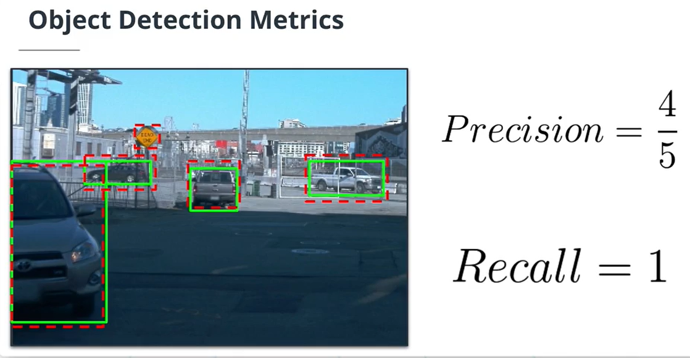
Green Box- Ground Truth
Red Box- Model’s Prediction
True Positives in the case of Object detection is found out using the concept of IOU (Intersection over Union)

Slide 37
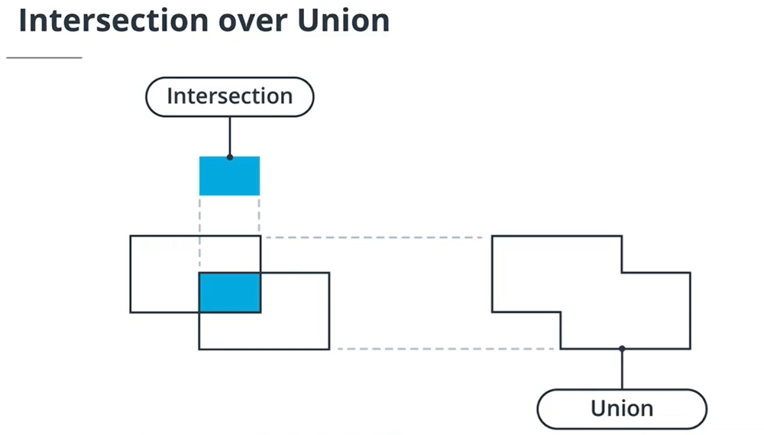

Slide 38
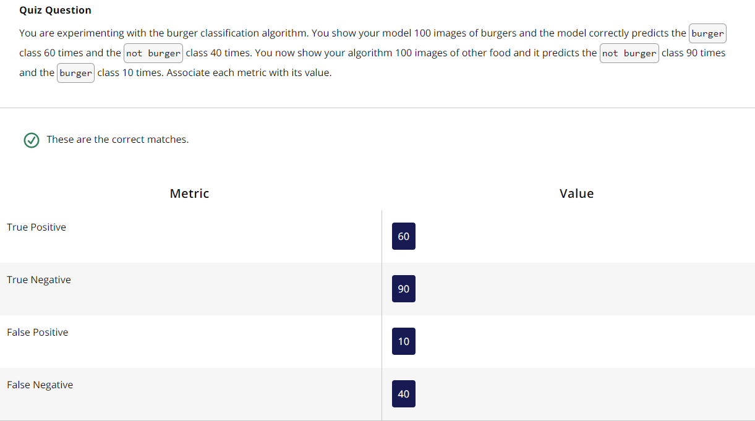

Slide 39
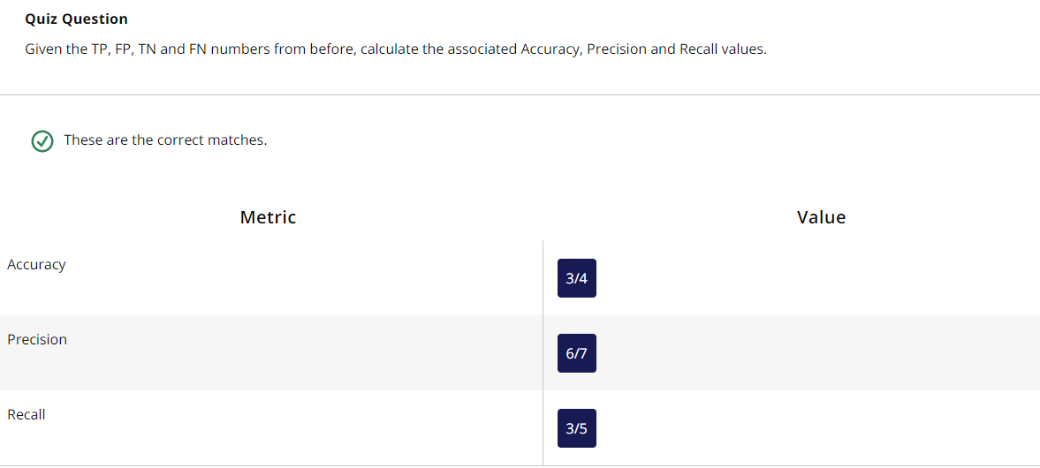

Slide 40


Slide 41



Slide 42



Slide 43


Slide 44


Slide 45



For new data polynomial regression does not generalize well
We try to fil a linear regression model
We try to fil a Polynomial regression model
For new data linear regression generalizes well

Slide 46


The challenge in ML lies in creating a model that performs well on available data without overfitting

Slide 47

We would like our model to generalize well to unseen datasets during training. We are going to analyze the performances of our algorithms on test data sets, In particular, we are interested in test error which is the error rate of the model in test dataset.
1- As the complexity (Number of parameters) of the model increases, the bias (In red) decreases. However, the variance (In purple) increases with increase in complexity. It loses its ability to generalize.
2- If we sum both terms, we get the test error in blue (On the top). The blue curve shows existence of an optimal complexity where the test error is minimized ( around (1.2,5).
3- this is called bias- variance tradeoff. You want your model to be complex enough for low bias. But not too complex so that you can still generalize to unseen data
To minimize the test error, we have to minimize both bias and Variance. We need to minimize both bias and variance, which means our model should work well both on training data and test data. However, by minimizing the bias, we tend to increase the variance.

Slide 48


Slide 49

(80%-90%)
Training data
So, we train our model using the training set and check the model performance with the cross validation set. If everything is satisfactory, then we test it using the testing set.
Total Data
Testing data
(20%-10%)
This is how it is done generally, but we can also have a validation. This will help in the following way:
(70%)
Training data
Total Data
(15%)
Testing data
Only used once our model has been chosen
(15%)
Cross Validation data
This is done to evaluate our model and choose the best parameters for the model to minimize the error

Slide 50


Slide 51



Slide 52



STEPS INVOLVED IN MODEL SELECTION
STEPS 1: Establish Baselines
STEPS 2: Start building different models. Start with simple model and then iterate to select the best model
STEPS 3: How to iterate

Slide 53


Slide 54



Slide 55



The model detects some cars correctly, but not all of them.
1- In the left figure, Cars in the foggy region are not detected correctly. So, the model should be trained with foggy data.
2- In the figure on the right, smaller cars are not detected. So, we should see if the model can predict smaller cars by training it. If not, we should change the model.

Slide 56


Slide 57



Slide 58

A model is as good as its data

Slide 59


Slide 60
3- Sensor and Camera Calibration

Slide 61


The camera sensor
DL basically uses digital Images. So, we better know about the sensor that captures the data.

Slide 62



How does human vision works?
Human eye captures light that is reflected from the objects. Receptors inside our eyes convert the light into electrical signals and they are then transmitted to the brain. The brain transforms the messages into the images we see. A camera works differently.
Working of a camera
It captures and focusses the light on lenses that are placed in front of digital sensors. Depending on the model, a camera can have one or more lenses. The light signal is then received by digital sensor that captures it in digital format. There are many formats in which the diogital images can be saved such as JPEG and PNG.

Slide 63


Slide 64

CAMERA DISTORTION CORRECTION
When a camera looks at a 3D object in a real world and converts into a 2D image, this transformation is imperfect. This is called camera Distortion. Because of this distortion, the lanes become curved, which is a problem for Self Driving cars. So, we should undo this so that we can make correct decisions.

Slide 65


Slide 66

Camera Pinhole Model
When a camera forms an image, it is looking at the world like how our eyes see the world

Slide 67

Types of Distortion
1- Radial Distortion
2- Tangential Distortion
3- There are also distortions in Fish-eye cameras. These distortions are induced intentionally.

